Slide 1
Category review: Chips
June 2020
Retail Analytics
Brand note: If client logo is not required, use alternate title page layout right click slide thumbnail > Layout > Title

Slide 2
Notes:
To view Privacy video explaining how important data privacy is to Quantium, please click here: https://www.youtube.com/watch?v=Zq1QDAkoRzU
or here Q:\Company Reference\Brand & Design\Brand videos\Q Privacy.mp4
At Quantium, we believe that data is the behavioural footprint of humanity and that it has to be treated with the utmost care and responsibility.
Histories, attitudes, indeed lives are stored within it in ways that aren’t always apparent – and that’s what makes its potential so powerful.
To work with it responsibly, sensitively, we set ourselves the highest data privacy protection and governance standards.
We have spent 17 years perfecting privacy-by-design and secure-by-design principles. Central to this is not holding any personally identifiable information about people –
we neither receive it, and put the necessary protections in place to be unable to decipher it.
Every aspect of handling data is safeguarded: from its de-identification, to its encryption – data security is paramount and of the highest grade.
We pride ourselves on gaining the trust of iconic organisations around the world through years of securely working with their data,
and in turn the trust that builds with their stakeholders.

Slide 3
Executive summary
01
Task 1
• The three highest contributing segments to the total sales are: Budget older families, Mainstream young singles/couples, and Mainstream retirees.
• Key Sales Drivers: Older families have the highest average number of packets purchased per customer. Mainstream young singles/couples represent the largest population segment.
• Target Store Strategy: Mainstream young singles/couples are more likely to buy Tyrells chips as compared to other segments.
02
Task 2
• A trial involving a new store layout was conducted in three trial stores.
• Control stores were created to represent the prior performance of the trial stores.
• The trial resulted in a significant increase in both the total sales and customer numbers with the new layout

Slide 4
01
Category

Slide 5
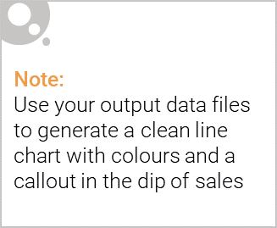
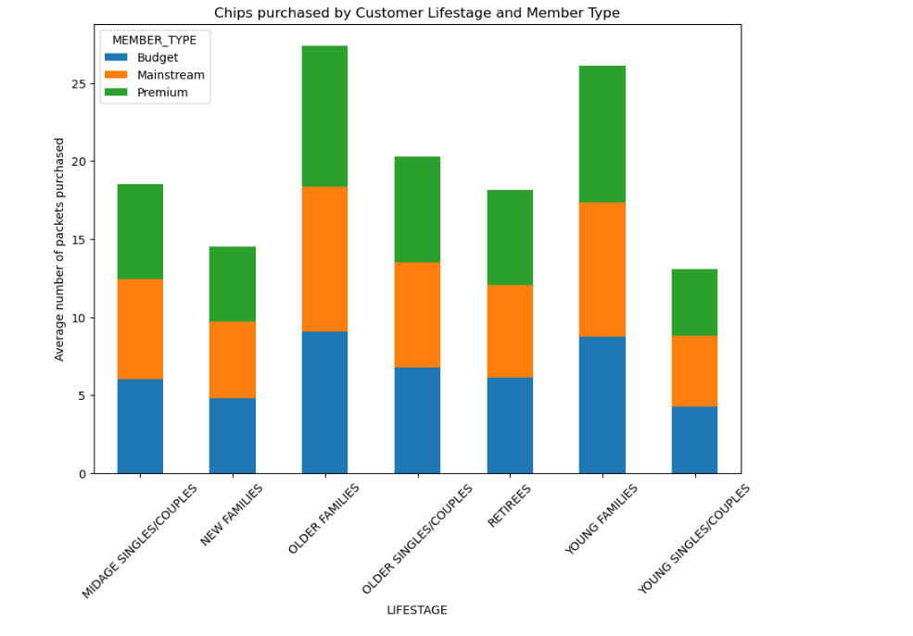
Older families and Young families tend to buy more chips on average as compared to other segments. Member types has insignificant affect on quantities of chips purchased

Slide 6

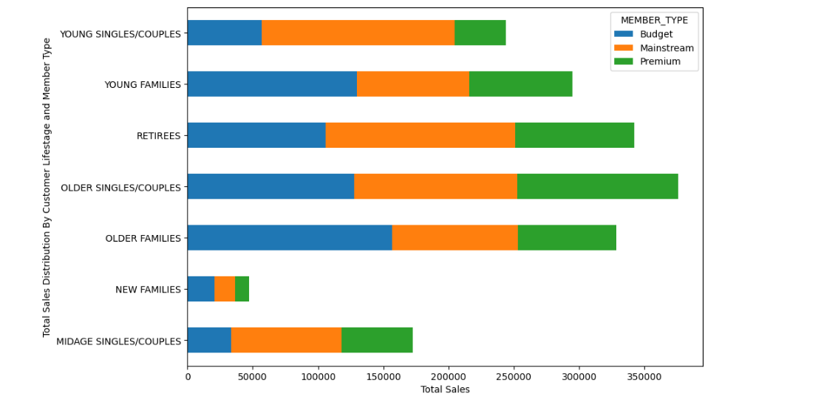
Most sales come from budget older families, followed by mainstream young singles/couples, and finally mainstream retirees

Slide 7
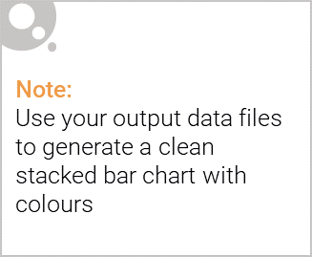
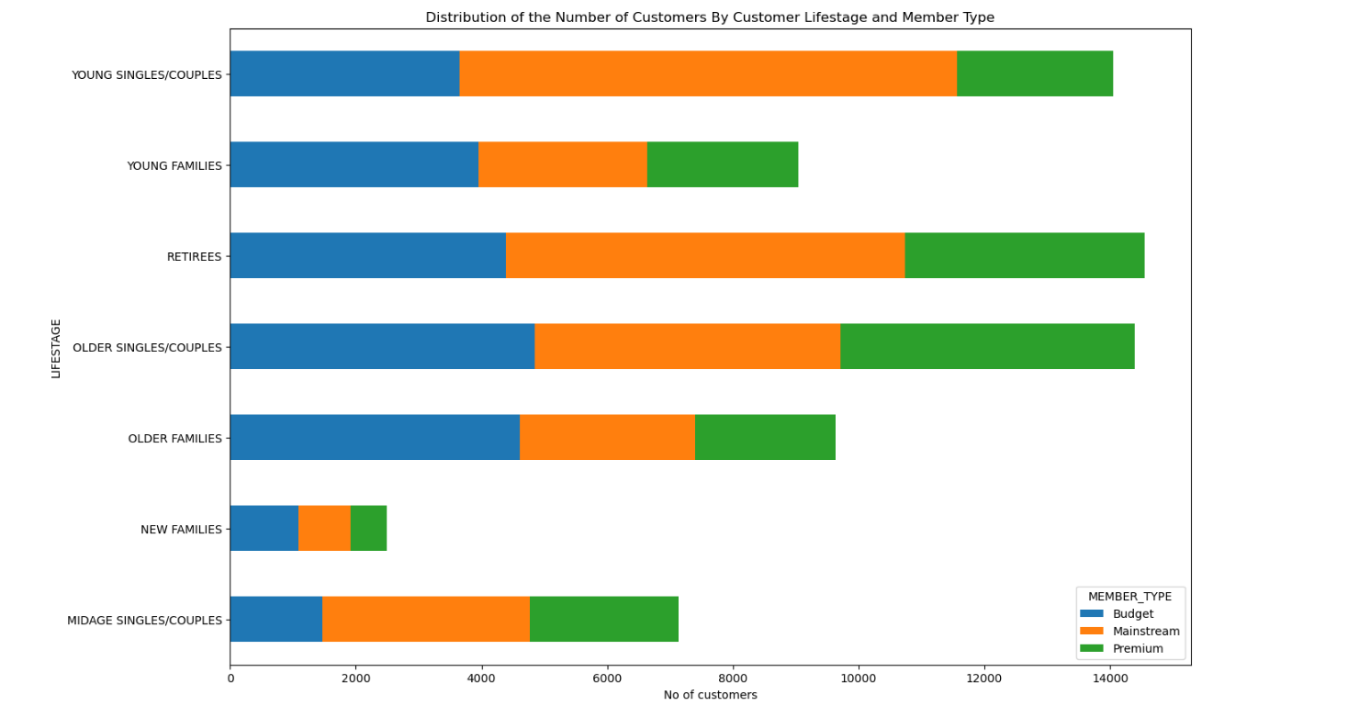
Editable (delete this)
Sales via mainstream young singles/couples is attributed to their population being the largest of all the segments

Slide 8
Editable (delete this)
Deeper Insight into the Mainstream Young Singles/Couples Segment
• Kettle chips are the most purchased brand across most segments.
• Mainstream young singles/couples are 28% more likely to buy Tyrells chips and 32% more likely to purchase 175g packets, which are exclusive to Twisties.
• Product Placement Strategy: Position Kettle chips and Twisties in areas highly visible to this segment.

Slide 9
02
Trial store performance

Slide 10
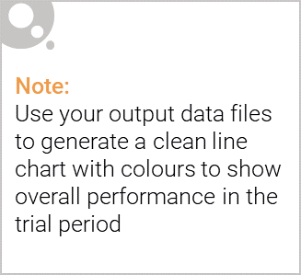
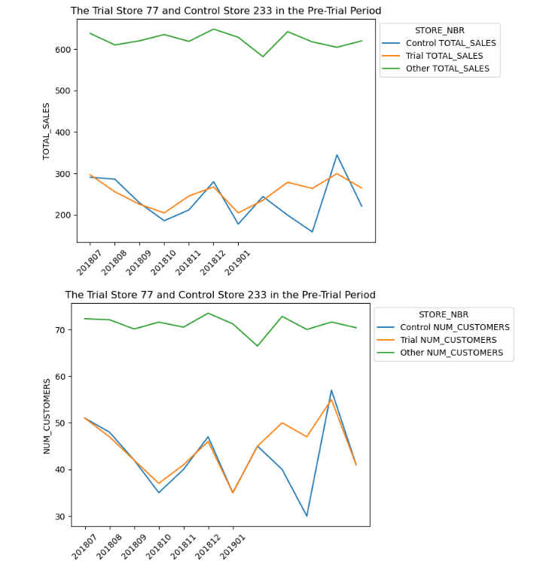
The control store is created to represent the prior performance of the trial store as compared to the average of other stores. See example, stores 77 and 233

Slide 11
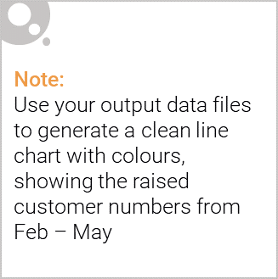
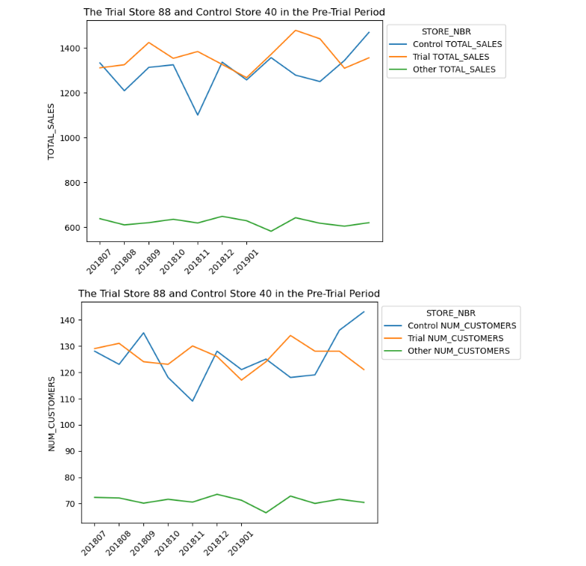
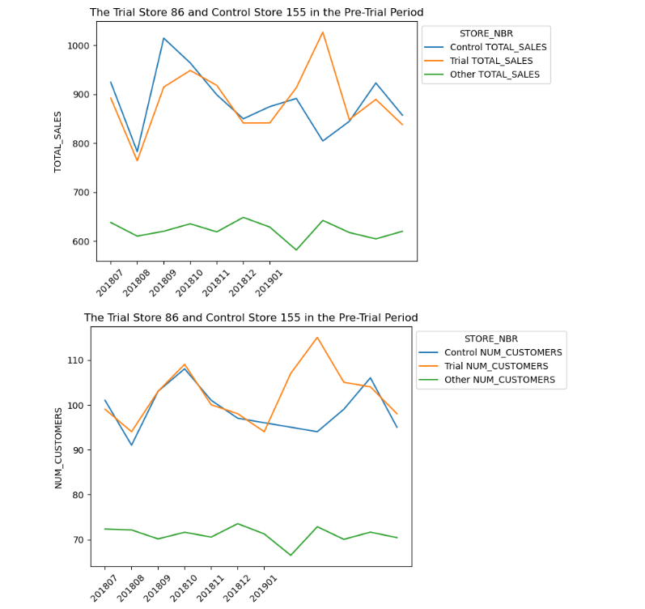

Slide 12
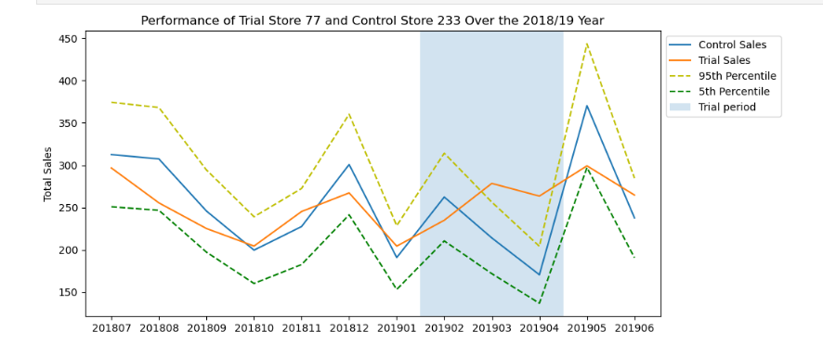
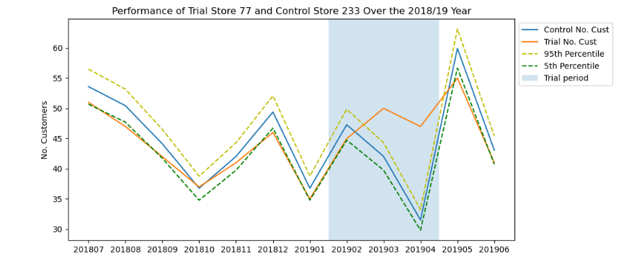
Trial store 77 and control store 233: trial success, with increases in sales and customer numbers.

Slide 13
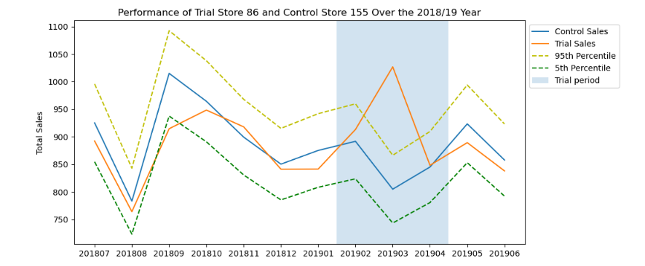
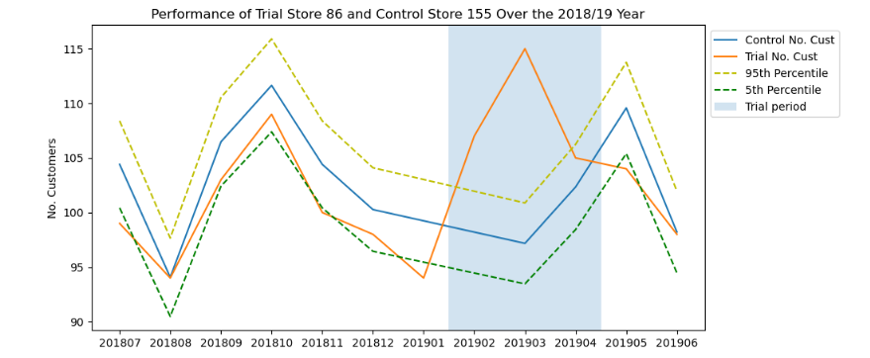
Trial store 86 and control store 155: trial success, greater increase in customer numbers than sales. Need to check the trial implementation.

Slide 14
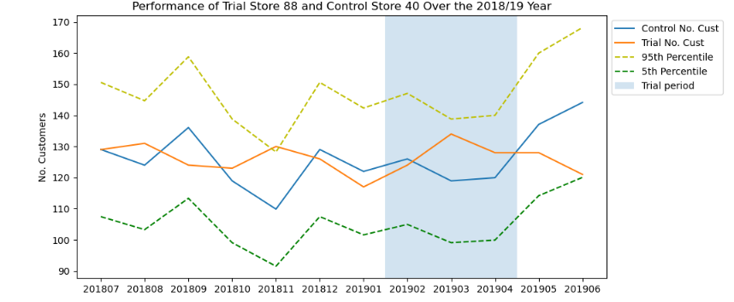
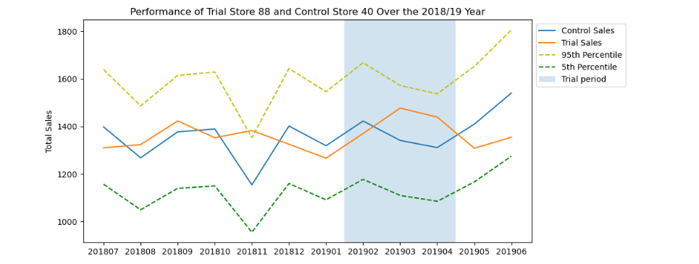
Trial store 88 and control store 40: no significant difference in performance

